Slide 1
Gen AI + Real World Business Tasks
Overview
This lesson focuses some real world case studies about how businesses are solving problems and creating solutions with generative AI.
Learning Objectives
Identify opportunities to use Generative AI to solve real-world business problems.
Evaluate the different ways that Generative AI can be used to solve a specific business problem.
Develop and implement a simple Generative AI solution to a real-world business problem.

Slide 2
Suggested Agenda (45 min)
0:00-0:02 Review Learning Objectives
0:02-0:05 How Can We Use LLMs for Automation?
0:05-0:30 Multimodal Models for Business Use Cases
0:30-0:40 Practice: Retail Augmentation
0:40-0:45 Reflection
*these are estimates - timings will vary!

Slide 3
Teaching Guide:
Use the following quick tips for instructional guidance.
Title | What to Do
Learning Objective Slides | Pause to unpack the learning objectives and prime students for the lesson. This is a crucial step in the learning process and gives participants time to build context and activate any prior knowledge.
Solo Activities | For solo activities, you can choose to put people in group breakout rooms (to create the “table” group that they would be in in a physical setting) or allow students to work independently in the main session.
Group and Partner Discussions and Exercises (Remote) | Creating Breakout Rooms — Group and Partner Exercises Set up breakout rooms for pairs/groups. Broadcast directions and discussion questions to all breakout rooms. At the 60-seconds-left mark, broadcast a message to all rooms: “Start to wrap up your discussions. Rooms will close in one minute!” Move around from breakout room to breakout room to “walk around the classroom.”
Group and Partner Discussions and Exercises (In Person) | Facilitating Group and Partner Discussions and Exercises — Live Classroom Arrange the room prior to the session to create a conducive environment for group work. Provide clear, concise instructions verbally and on a handout or slide for the exercise, ensuring that all participants are aware of the goals and the time allocated. Circulate around the room to engage with groups Display a timer or announce when there is 1 min remaining Facilitate the sharing of group conclusions or discussion points with the whole class, ensuring that each group has a voice.

Slide 4
Apply Generative Al to real-world business tasks

Slide 5
Identify opportunities to use Generative AI to solve real-world business problems.
Evaluate the different ways that Generative AI can be used to solve a specific business problem.
Develop and implement a simple Generative AI solution to a real-world business problem.

Slide 6
How Can We Use LLMs for Automation?
💬 Reusable LLM Prompts
To tackle repetitive tasks in the chat interface.
Notes:
We’re going to start with a case study from Moody’s, the ratings agency. This is an example of an LLM-powered business application.

Slide 7
How Can We Use LLMs for Automation?
💬 Reusable LLM Prompts
To tackle repetitive tasks in the chat interface.
🦾 Build LLM into Automation Tools
Using No-code Tools.
Notes:
We’re going to start with a case study from Moody’s, the ratings agency. This is an example of an LLM-powered business application.

Slide 8
How Can We Use LLMs for Automation?
💬 Reusable LLM Prompts
To tackle repetitive tasks in the chat interface.
🦾 Build LLM into Automation Tools
Using No-code Tools.
👩🏽‍💻 LLM generates Code
To tackle repetitive tasks on device or in the Cloud.
Notes:
We’re going to start with a case study from Moody’s, the ratings agency. This is an example of an LLM-powered business application.

Slide 9
How Can We Use LLMs for Automation?
💬 Reusable LLM Prompts
To tackle repetitive tasks in the chat interface.
🦾 Build LLM into Automation Tools
Using No-code Tools.
👩🏽‍💻 LLM generates Code
To tackle repetitive tasks on device or in the Cloud.
🗄️ LLM-powered Business Apps
Created by internal developers, often “fine-tuning” a model.
Notes:
We’re going to start with a case study from Moody’s, the ratings agency. This is an example of an LLM-powered business application.

Slide 10
Multimodal Models for Business Use Cases

Slide 11

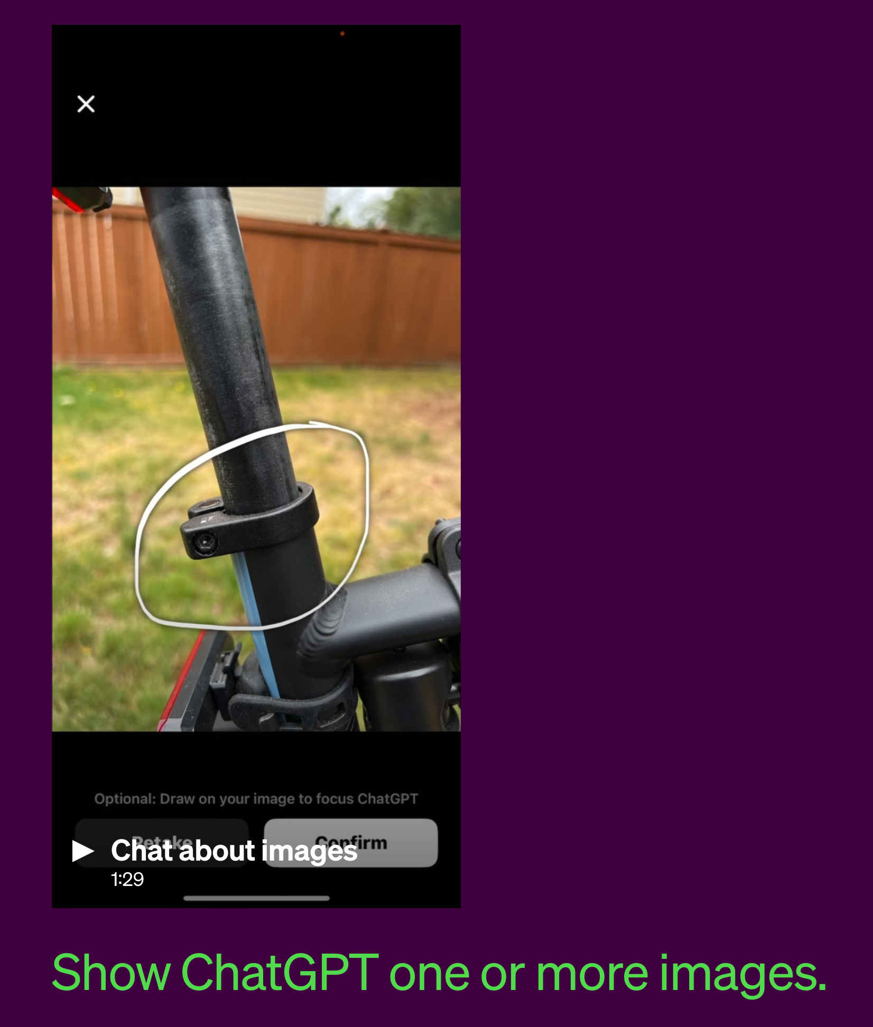
Large Language Models → Large Multimodal Models
Large Language Models can also apply their language reasoning skills to images, such as photographs, screenshots, and documents containing both text and images.
GPT-4(V) is one such example.

Slide 12
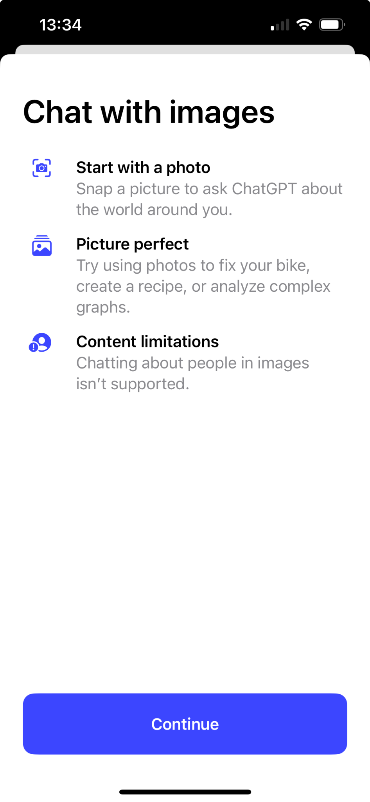
Multimodal for Business
Inputs:
Text
Image
Audio
Video
Interfaces:
OpenAI API
Bing AI
ChatGPT Plus
Foundational Models:
GPT-3.5
GPT-4(V)
DALL-E 3
Notes:
Large Multimodal Models can take in different types of data as input - Text, Image, Audio, and, in the future, video.
Let’s dig into a few early use cases that have been identified in one of the first papers to be published on LMMs.

Slide 13
Let’s go over a few examples that showcase the power of these multimodal LLMs!

Slide 14
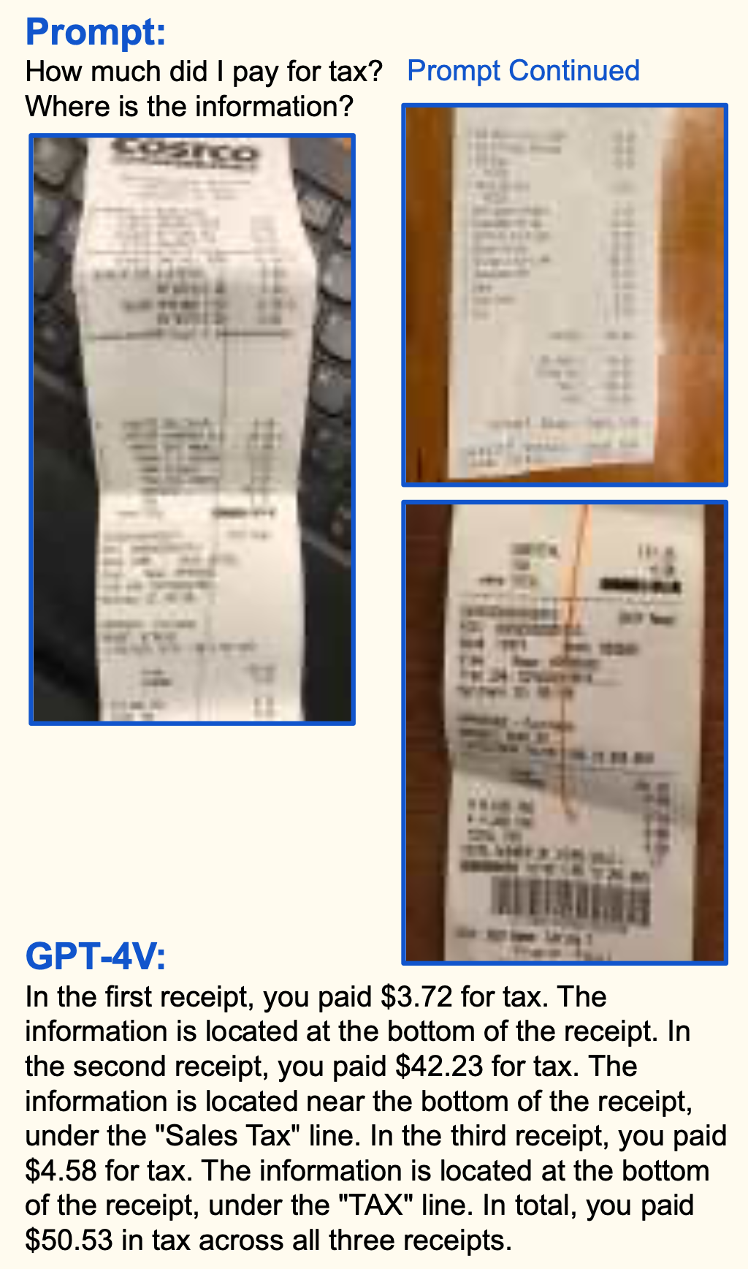
GPT-4V Spotlight: Receipt Management (Automation)
Harnessing the dual prowess of text and image comprehension, GPT-4V deftly extracts data from intricate visual content.
Ushers in lightning-fast processing even for bad photos/scans of receipts.
Traditional tools lean on classic machine learning and default to human intervention, resulting in processing lags for anomalies, GPT-4V side steps such delays.
The upshot? Immediate and precise financial tracking and analytics.
Source: The Dawn of LMMs: Preliminary Explorations with GPT-4V(ision)
Notes:
PURPOSE:
Highlight GPT-4V's capability in extracting information from visual content, specifically receipts, and its advantages over traditional methods.
TALKING POINTS:
• GPT-4V's unique ability to combine text and image comprehension, allowing for precise data extraction.
• Its speed and efficiency, even when handling poor-quality images.
• Comparison with traditional tools that rely heavily on classic machine learning and human intervention.
TEACHING TIPS:
• Consider providing real-life scenarios where such a feature can be beneficial.
• Emphasize the speed aspect – time saved in businesses due to automation.
• Highlight the importance of accurate financial tracking and how GPT-4V can contribute to it.

Slide 15
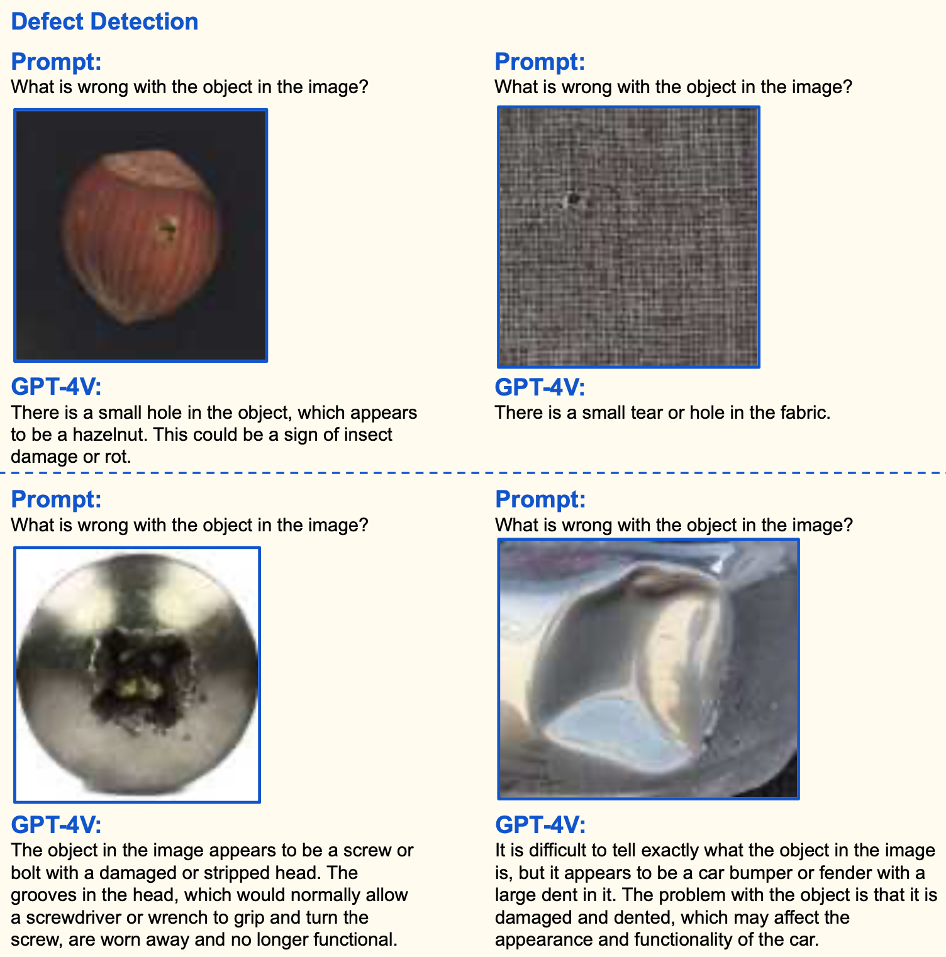
GPT-4V Spotlight: Manufacturing (Automation)
Rapid Defect Identification: GPT-4V can swiftly pinpoint issues in a variety of objects, from food items to textiles.
Precision in Details: Not just identifying the defect, but also providing context - like possible insect damage in a hazelnut or wear on a screw head.
Potential for Automation: Integrating GPT-4V can enhance automated quality checks in manufacturing, reducing manual inspection needs and errors.
Source: The Dawn of LMMs: Preliminary Explorations with GPT-4V(ision)
Notes:
PURPOSE:
Highlight the capabilities of GPT-4V in manufacturing automation, focusing on defect identification and precision.
TALKING POINTS:
• Introduce GPT-4V's ability to rapidly identify defects in a variety of objects.
• Emphasize the detailed analysis GPT-4V provides, not just spotting the defect but also giving context.
• Discuss the potential for automating quality checks in manufacturing with GPT-4V, reducing human error and manual inspection.
TEACHING TIPS:
• Use real-world examples to showcase the importance of defect identification in manufacturing.
• Highlight the difference between traditional inspection methods and GPT-4V's approach.
• Mention potential cost savings and efficiency improvements by using GPT-4V.

Slide 16
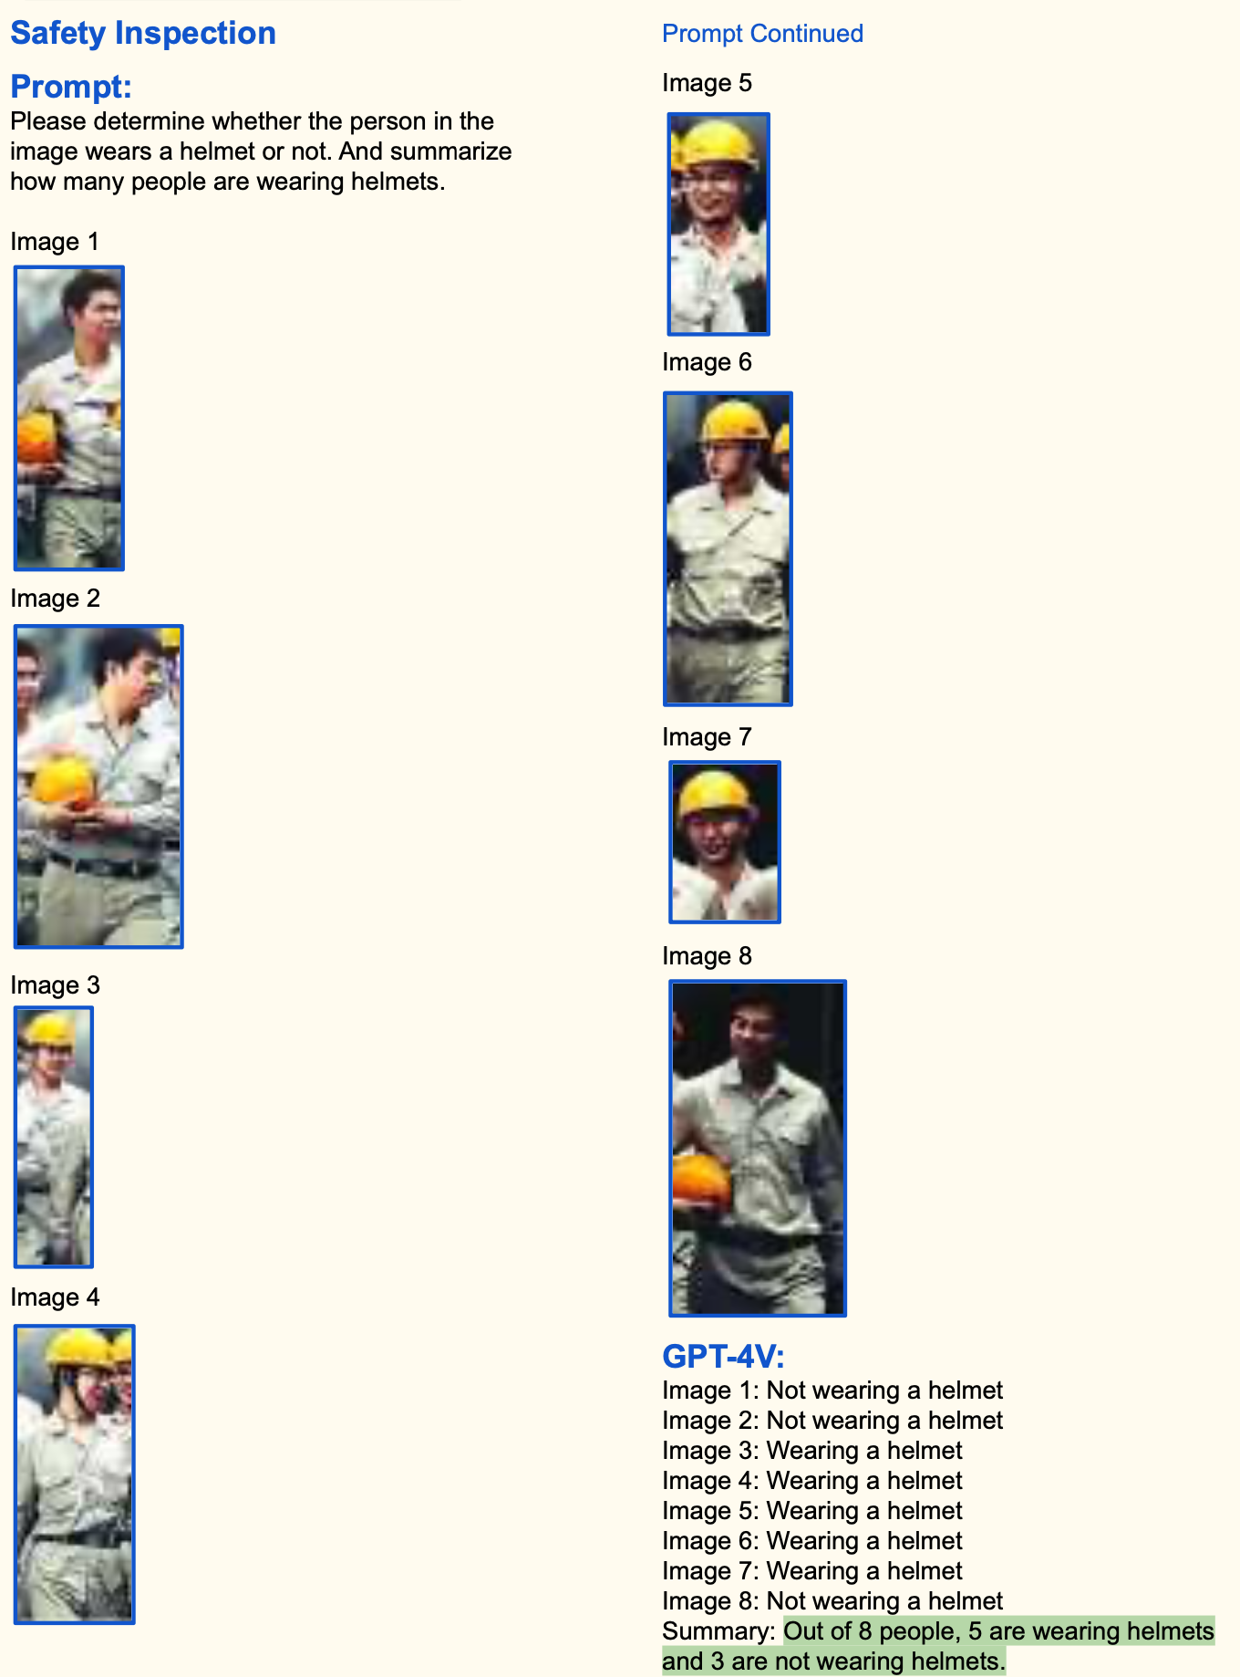
GPT-4V Spotlight: Industry (Augmentation)
In this example, GPT-4V works in tandem with Deep Learning Person Detection algorithm.
Person Detection: Before GPT-4V takes the reins, a person detector identifies every individual on the site, chunking up video stills to send to GPT-4V.
Safety Compliance Check: Once we have our cropped images of every worker, GPT-4V steps in. It meticulously analyses each image-text pair, pinpointing even the subtlest of safety violations.
Source: The Dawn of LMMs: Preliminary Explorations with GPT-4V(ision)
Notes:
PURPOSE:
Demonstrate GPT-4V's potential in industry augmentation, especially in safety compliance checks.
TALKING POINTS:
• Outline how GPT-4V works in tandem with a Deep Learning Person Detection algorithm.
• Describe the process of person detection, followed by GPT-4V's analysis for safety compliance.
• Showcase the precision of GPT-4V in detecting safety violations, even subtle ones.
TEACHING TIPS:
• Point out the significance of safety compliance in industries, especially in construction or factory settings.
• Highlight the advantage of using technology like GPT-4V to assist in ensuring workplace safety.

Slide 17
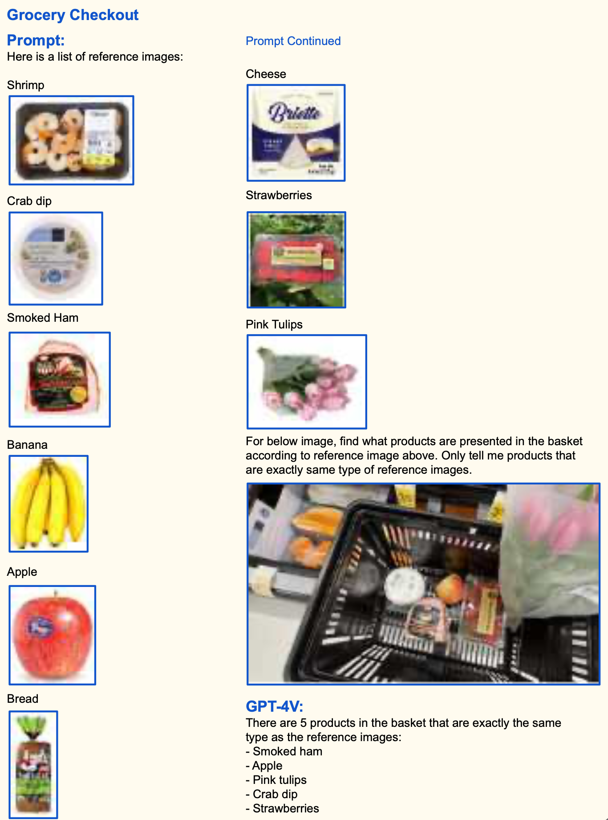
GPT-4V Spotlight: Retail (Automation)
Here the potential is for GPT-4V in to enable an automatic self-checkout system.
Reference-Powered Checkout: By using reference images, GPT-4V swiftly identified grocery items in the user’s basket..
Beyond Barcodes: rather than scanning each individual item at self checkout, the customer would simply photo-scan the whole basket.
Source: The Dawn of LMMs: Preliminary Explorations with GPT-4V(ision)
Notes:
PURPOSE:
Highlight the practical applications of GPT-4V in the retail sector, particularly in automating the self-checkout process.
TALKING POINTS
• Introduction to the concept of Reference-Powered Checkout and how GPT-4V can leverage it.
• Advantages of using image references to swiftly identify grocery items, enhancing user experience.
• Brief on the "Beyond Barcodes" concept, emphasizing the convenience of scanning an entire basket at once.
TEACHING TIPS
• Use real-life examples to explain how this technology could revolutionize traditional grocery shopping.
• Engage the audience with a hypothetical question like, "How many of you have been frustrated with self-checkout machines before?"
• Pose the potential benefits against any perceived challenges or privacy concerns.

Slide 18
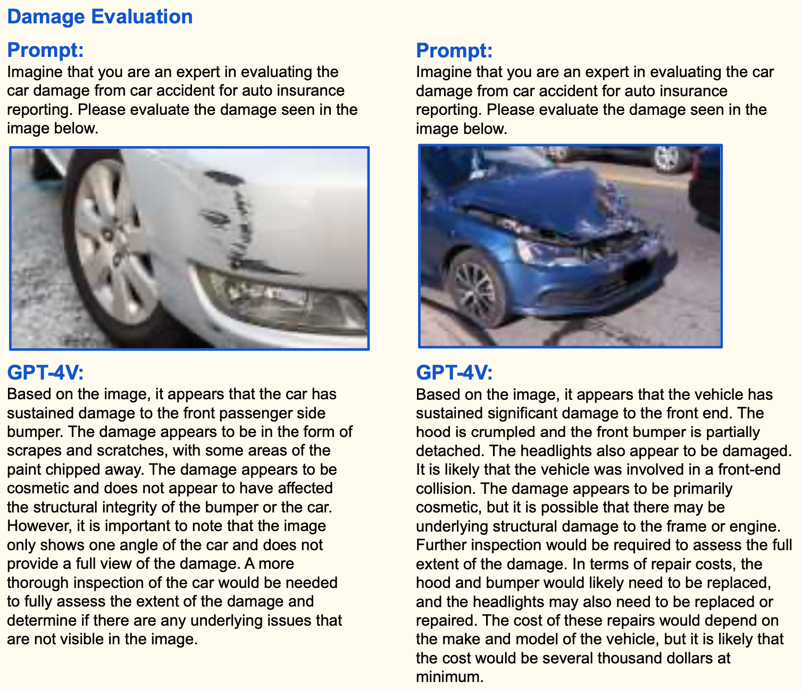
GPT-4V Spotlight: Insurance (Augmentation)
Double Duty – Evaluation & Reporting
Damage Evaluation: Imagine entrusting a machine with inspecting vehicle damage after an accident. GPT-4V estimates depth of damage, the context, and even hints at repair costs.
Insurance Reporting: building on damage evaluation, GPT-4V can also identify car make, model, and license plates, even when badly damaged.
Source: The Dawn of LMMs: Preliminary Explorations with GPT-4V(ision)
Notes:
Car accident reporting isn't just about what's visible. It's about stitching together a story from multiple angles – something real-life insurance leans heavily on but is a rarity on the net. PURPOSE:
Explain the transformative impact of GPT-4V on the insurance industry, especially in vehicle damage evaluation and reporting.
TALKING POINTS
• The potential of machine-assisted vehicle damage assessment following an accident.
• How GPT-4V can estimate the depth of damage, offer insights into the context, and even provide repair cost hints.
• The enhanced capabilities of GPT-4V in insurance reporting, emphasizing its ability to identify car details even when damaged.
TEACHING TIPS
• Present a comparison between traditional human-assessed damage reports and machine-assisted ones.
• Discuss the advantages in terms of speed, accuracy, and objectivity when using a system like GPT-4V.
• Engage the audience with a question such as, "How would you feel trusting a machine with your car's damage evaluation?"

Slide 19
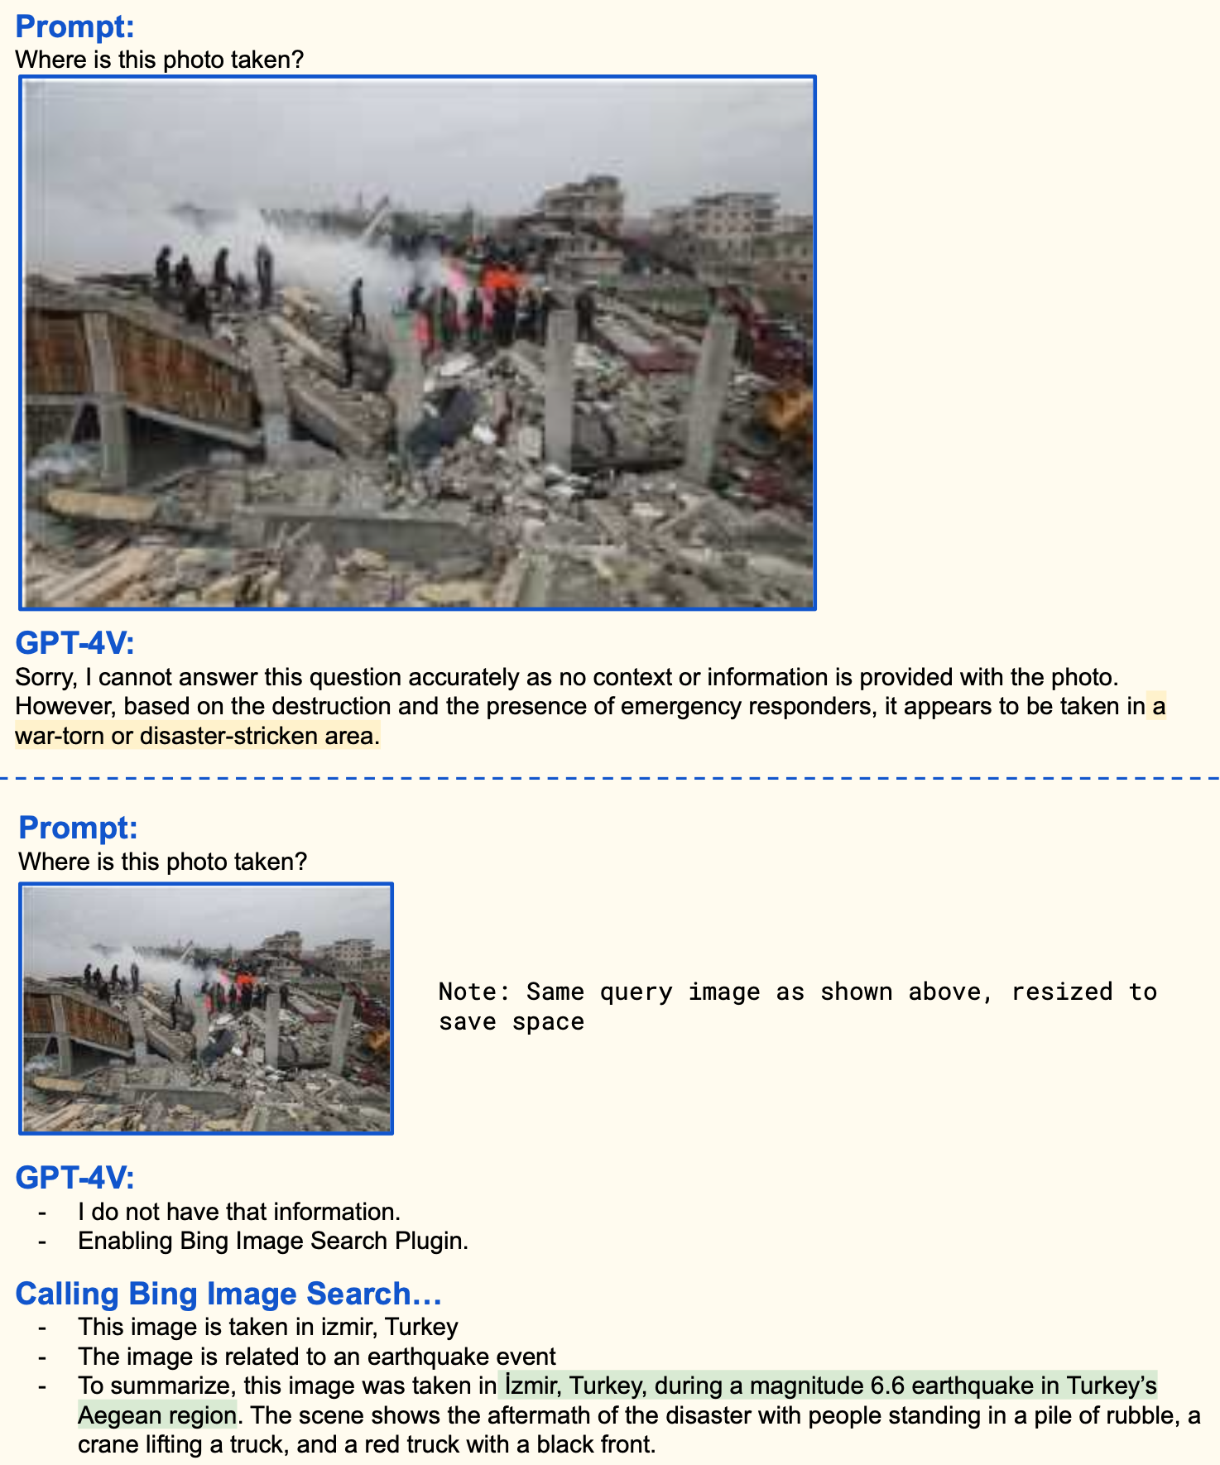
GPT-4V Spotlight: News/Social Media (Augmentation)
Fact Checking: Bing + GPT-4V
As we’ve seen recently, misinformation runs rampant on social media.
Exploitative actors have been using old footage, or even scenes from video games, to polarize public opinion in current conflicts.
This use case could offer a swift way for platforms to flag or reduce the reach of such disinformation.
Source: The Dawn of LMMs: Preliminary Explorations with GPT-4V(ision)
Notes:
Highlight the capabilities of GPT-4V in the context of fact-checking for news and social media by showcasing its integration with search engines like Bing for image-based queries.
TALKING POINTS:
• Emphasize the prevalent issue of misinformation on social media platforms.
• Note how malicious actors use misleading visuals, including outdated footage or even video game scenes, to manipulate public sentiment.
• Discuss the potential of GPT-4V, when paired with search tools, to swiftly detect and mitigate the spread of such deceptive content.
TEACHING TIPS:
• Encourage learners to consider the importance of accurate information in today's digital age.
• Point out the two different prompts to highlight the model's response variability based on available context.
• Use the image results to demonstrate the practical application of the tool in a real-world scenario.

Slide 20
Multimodal Advancements

Slide 21
Multimodal Advancements: OpenAI
GPT-4V
GPT-4o
GPT-?
Where We Started
Where We Are
Where We Will Go

Slide 22

GPT-4o
Overall GPT-4o performs similarly to GPT-4V, but it is much faster.
The increased speed leads to a more immersive experience were users can have conversations with the model.
Check out this video from OpenAI highlighting the conversational capabilities of GPT-4o!
Notes:
PURPOSE: Introduce GPT-4o, highlighting its speed and conversational capabilities.
TALKING POINTS:
GPT-4o performs similarly to GPT-4V, but it is significantly faster.
The increased speed leads to a more immersive experience where users can have more fluid conversations with the model.
Encourage the audience to watch the linked video from OpenAI, which showcases the conversational capabilities of GPT-4o.
TEACHING TIPS:
Emphasize the practical implications of the increased speed in real-world applications.
Discuss potential use cases where the enhanced speed of GPT-4o could be particularly beneficial.
Highlight how this technology may lead to users having an AI assistant that can see and hear the things they are seeing and hearing
Suggest viewers think about how they might leverage GPT-4o's speed in their own projects or interactions.

Slide 23

Think About It: Multimodal LLMs 🤔
Which use-case of multimodal LLMs was the most impressive to you? Can you think of other applications relevant to you or your industry?
Type your response in the chat.

Slide 24
Retail Augmentation

Slide 25
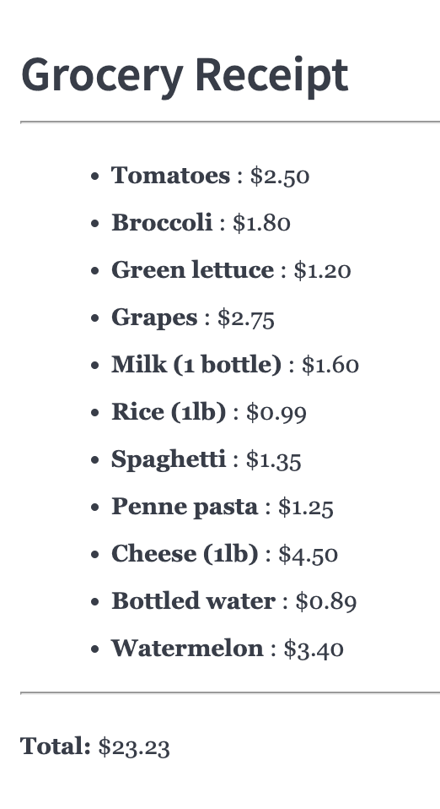

Practice: Retail Augmentation
10 Minutes
Instructions:
1
Take a screenshot of the grocery basket and receipt then paste/upload them into ChatGPT.
2
Ask “Are there any discrepancies between the receipt and the grocery basket?”
3
Double check ChatGPT’s response and provide feedback as necessary.
4
BONUS: Think about how things changed from GPT-4V to GPT-4o. How could you do this activity differently with each model? How might it change in the future?
Notes:
SOLO ACTIVITY
Go through the instructions - provide a quick demo if students are confused.
Students complete activity. Monitor their progress and answer questions throughout.
Debrief after the activity:
After reviewing ChatGPT's analysis, what discrepancies, if any, did you find between the items listed on the receipt and the actual items in the grocery basket?
How might the discrepancies found during this exercise impact the customer experience, and what steps could be taken to prevent such issues?

Slide 26
Real-World Business Tasks

Slide 27
Reflection: Real-World Business Tasks
1
If you work in a large organization, what AI powered business apps are being used?
2
Do you have any new ideas for how you may be able to introduce Gen AI and it’s multimodal capabilities to your role/business?
Notes:
- Ask participants to reflect on their own, either in their own heads or by jotting down notes
- If they would like to share their reflections, let them know they can do so in the Zoom chat

